Slide 1
LIVE RAG
STREAMING LIVE RAG
AN EVENT-DRIVEN ENGINE THAT RETRIEVES WHILE YOU'RE STILL TALKING
THEME 4
Samsung PRISM GenAI Hackathon
TEAM
HackHazards

Slide 2
Problem Statement
Every time a person talks to an AI system today — a support chatbot, a voice assistant, a research tool — the underlying process is the same: the person finishes speaking, waits, and only then does the system start thinking. It listens, ignores everything until the user stops, searches once, and answers once. This is how virtually every Retrieval
Augmented Generation (RAG) system works today — a batch-oriented design pretending to be a conversation.
A call-center moment
Customer: "My phone screen cracked, is it under warranty, how long does repair take, and can I get a loaner?"
→ one search for 3–4 questions.
Then: "Oh wait, I bought it from a third-party seller." → batch RAG either ignores it (wrong answer) or restarts and throws away what was correct.
The gap: real conversations are streaming, layered and self-correcting. Today's RAG is none of those.

Slide 3
What We're Building
1 Listc⭲s i⭲cícmc⭲tallQ
Reads timestamped transcript chunks as they arrive
Compares the running buffer to topic clusters
Vague input means WAIT, and a clear match forks one retrieval branch
A near-tie forks up to 4 cheap retrieval-only branches
2 Dccomposcs multi-i⭲tc⭲
Different clusters become parallel sub-queries Clauses in the same cluster stay one question (no over-splitting) Merges the answers into one cited response Splits the utterance into clauses at a boundary
C Rcﬁ⭲cs, ⭲cvcí ícstaíts
4 Guaía⭲tccs oíou⭲di⭲o
Zero Hallucinations: Outputs only verified, source-backed facts. Full Traceability: Every generated claim includes a direct citation. No Guessing: Actively refuses to answer if information is missing. Restricted Context: Answers exclusively from authorized, retrieved documents.
A slot-diff finds what the late detail changed
Embedding proximity flags the stale claims
Re-searches and re-verifies only those claims
Keeps the other citations and bumps the answer version by one

Slide 4
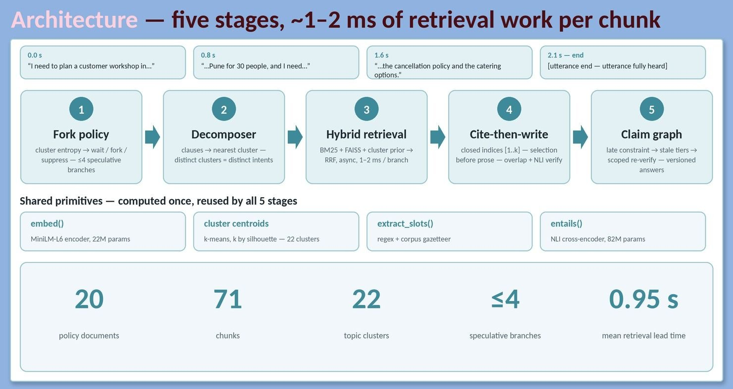
System Architecture

Slide 5
How We Prevent Hallucination
Retrieve chunks
Top evidence from the corpus, scoped by topic cluster.
Mask the IDs
Chunks are shown only as [1], [2], [3]. Real Doc_IDs are never visible.
Write + cite
Each claim cites an index, so a fake [Doc_999] cannot be produced.
Verify twice
Keyword/entity overlap, then NLI entailment against the cited chunk.
Pass both checks
Index mapped back to the real [Doc_ID §Section]; the claim is shown.
Fail either check
Claim dropped and replaced with an explicit uncertainty flag.
A structural guarantee, not a promise. Targets G4: ≥85% citation support, zero fabricated IDs.

Slide 6
How We Refine, Not Restart
ANSWER v1
ANSWER v2
Warranty coverage [cited]
Warranty: re-checked for third-party purchase
Late detail: "bought from a third-party seller"
Repair time [cited]
Repair time: unchanged, citation kept
Loaner availability [cited]
Loaner availability: unchanged, citation kept
1 Slot-diff: what changed?
2 Find stale claims by embedding proximity
3 Re-search a scoped subset only
4 Re-verify, answer version
+1

Slide 7
Live Demo / Timeline View
Time | Decision | What happens
t+0.4s | WAIT | Buffer too vague, no cluster match. No search.
t+0.9s | RETRIEVE | Clear topic match. Single branch forked early.
t+1.6s | FORK ×N | Near-tied clusters. Up to 4 retrieval-only branches.
t+2.0s | DECOMPOSE | 3 clauses become 3 independent sub-queries.
t+2.3s | ANSWER v1 | Streamed answer with [Doc_ID §Section] citations.
t+3.5s | PATCH → v2 | Late detail. Only stale claims re-searched.
t+4.1s | SUPPRESS | "Repeat that in two bullets": retrieval_required = false.

Slide 8
Benchmark Results
Gate | Criterion | Target | Batch baseline | Ours
G1 | Reproducibility | Pass / fail: one command | to measure | to measure
G2 | Early retrieval | ≥ 80% of eligible queries | to measure | to measure
G3 | Multi-intent identification | ≥ 70% of compound queries | to measure | to measure
G4 | Factual grounding | ≥ 85% support, 0 fabricated IDs | to measure | to measure
G5 | Session refinement | Verified state continuity | to measure | to measure
G6 | Telemetry | 100% trace coverage | to measure | to measure

Slide 9
Engineering Trade-offs / Ablations
Ablation 1: hybrid vs dense-only
BM25 + FAISS with RRF against FAISS alone. Measure citation support (G4) and retrieval precision.
Ablation 2: rule-based vs model-based controller
Vector-math fork policy against an LLM deciding when to search. Measure early retrieval (G2), false triggers, latency.
Edge-case failures to document (at least 3)
Candidates: premature retrieval on noise · over-fragmented sub-queries · a late detail that should change no claim.
Parsimony: two small shared models, no agent per stage. Every component must justify its latency.

Slide 10
Why It Wins
1
Direct gate alignment
Every design choice maps to scored gates G1–G6.
2
Architectural parsimony
Two small shared models instead of one agent per stage.
3
Cannot fabricate citations
The generator only ever sees anonymised chunk indices.
4
Claim-level patching
The hardest requirement, done properly, not "re-run everything".
5
The demo shows its reasoning
Live timeline of decisions, answer versions and sources.

Slide 11
Roadmap / What's Next
Voice input
Live speech-to-text feeding the transcript stream.
Learned controller
Swap rules for a model if ablation 2 supports it.
Optional hosted LLM
Fluent generation, still gated by NLI checks.
Larger corpora
Multi-domain knowledge with incremental re-indexing.

Slide 12
THANK YOU
Streaming Live RAG
Theme 4, Samsung PRISM GenAI Hackathon Team: Ideanuts

